Slide 1
UNIT-3 Cryptographic Hash Functions
By
Dr. CH SITA KUMARI
Associate Professor

Slide 2
INDEX
CRYPTOGRAPHIC HASH FUNCTIONS:
Applications of cryptographic hash functions
hash functions based on cipher block chaining,
Secure Hash Algorithm (SHA)
Message authentication codes
Message authentication requirements,
Message authentication functions
MACs based on Hash functions: HMAC
Digital signatures,
Elgamal digital signature scheme
Schnorr digital signature scheme,
NIST digital signature algorithm,
Elliptic curve digital signature algorithm

Slide 3
Hash function
A hash function H accepts a variable-length block of data M as input and produces a fixed-size result h = H(M), referred to as a hash value or a hash code.
The principal object of a hash function is data integrity.
A change to any bit or bits in M results, with high probability, in a change to the hash value.
The kind of hash function needed for security applications is referred to
as a cryptographic hash function.

Slide 4
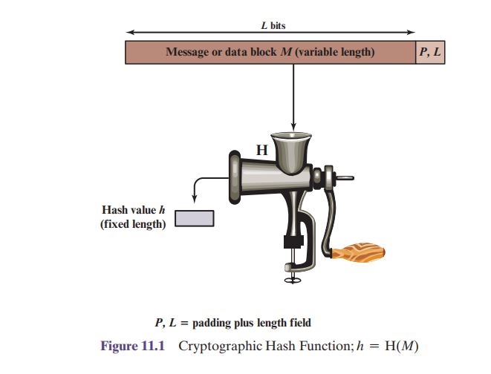

Slide 5
Applications of Hash functions
cryptographic hash function is used in
security applications and
Internet protocols.
To better understand some of the requirements and security implications for cryptographic hash functions.
Message Authentication
Message Authentication Code (MAC)
Digital Signatures (non-repudiation)
Message Integrity Check (MIC)

Slide 6
Message Authentication:
Message authentication is a mechanism or service used to verify the integrity of a message.
Message authentication assures that data received are exactly as sent (i.e., there is no modification, insertion, deletion, or replay)
When a hash function is used to provide message authentication, the hash function value is often referred to as a message digest.

Slide 7
The use of a hash function for message integrity is as follows.
The sender computes a hash value as a function of the bits in the message and transmits both the hash value and the message.
The receiver performs the same hash calculation on the message bits and compares this value with the incoming hash value.
If there is a mismatch, the receiver knows that the message has been altered

Slide 8
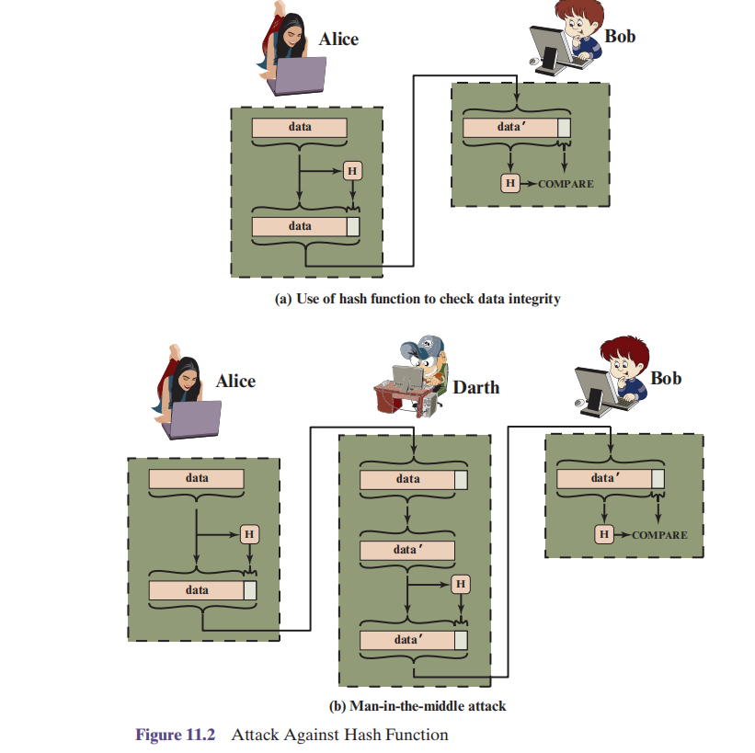

Slide 9
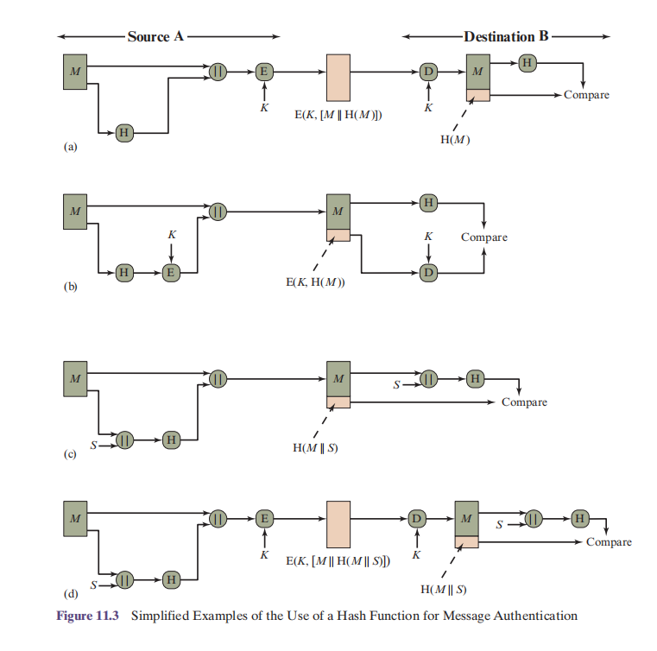
Examples of the Use of a Hash Function for Message Authentication(Symmtric key hashed)
Notes:
c and d MAC examples

Slide 10
message authentication code (MAC)
message authentication is achieved using a message
authentication code (MAC), also known as a keyed hash
function.
MACs are used between two parties that share a secret key to authenticate information exchanged between those parties.
A MAC function takes as input a secret key and a data block and produces a hash value
If the integrity of the message needs to be checked, the MAC function can be applied to the message and the result compared with the associated MAC value.
MAC algorithms are designed that are generally more efficient than an encryption algorithm.

Slide 11
Digital Signature
A DS is a mathematical technique used to validate the authenticity and integrity of a message s/w or digital document
which is similar to the message authentication application
The operation of the digital signature is similar to that of the MAC.

Slide 12
In the case of the digital signature, the hash value of a message is encrypted with a user’s private key.
Anyone who knows the user’s public key can verify the integrity of the message that is associated with the digital signature.
In this case, an attacker who wishes to alter the message would need to know the user’s private key.

Slide 13
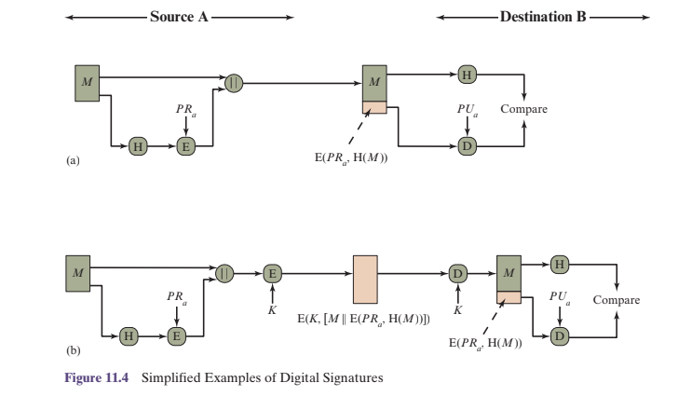
hash code is used in digital signature.

Slide 14
Other applications
Hash functions are commonly used to create a one-way password file.
Hash functions can be used for intrusion detection and virus detection.
A cryptographic hash function can be used to construct a pseudorandom function (PRF) or a pseudorandom number generator (PRNG)

Slide 15
Two simple hash functions
To get the understanding of security considerations involved in cryptographic hash functions, we present two simple, insecure hash functions
All hash functions operate using the following general principles.
The input (message, file, etc.) is viewed as a sequence of n -bit blocks.

Slide 16
The input is processed one block at a time in an iterative fashion to produce an n-bit hash function.
One of the simplest hash functions is the bit-by-bit exclusive-OR (XOR) of every block. This can be expressed as:

Slide 17
Ci = b_{i1} ⊕ b_{i2} ⊕ …… ⊕ b _{im}
where
Ci = i_{th} bit of the hash code, 1 ... i ... n
m = number of n-bit blocks in the input
b_{ij} = i^{th} bit in jth block
⊕ = XOR operation
This operation produces a simple parity bit for each bit position and is known
as a longitudinal redundancy check. It is reasonably effective for random data as a data integrity check.

Slide 18
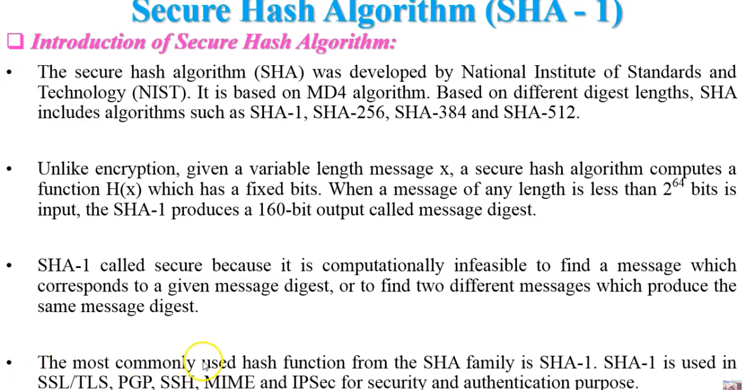
Secure Hash Algorithm (SHA)

Slide 19
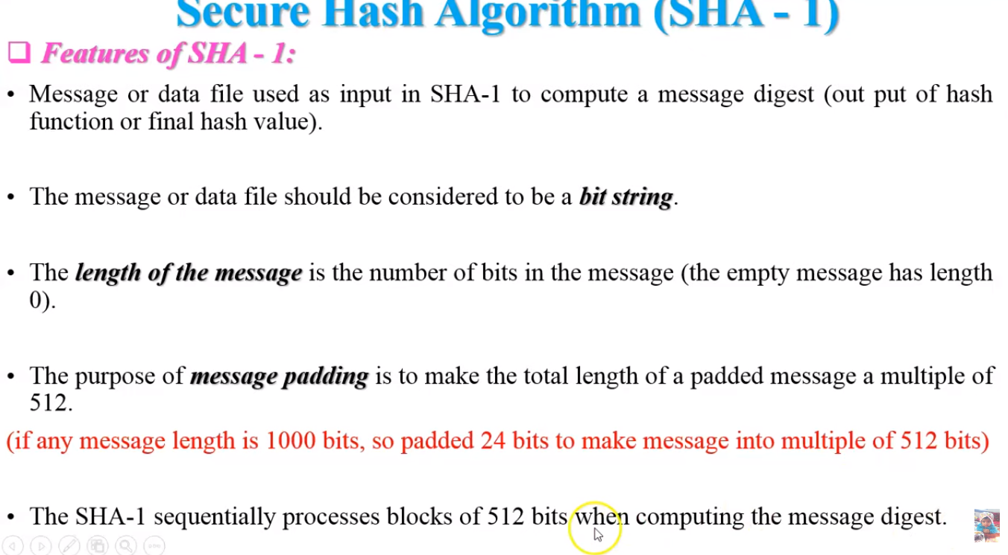

Slide 20
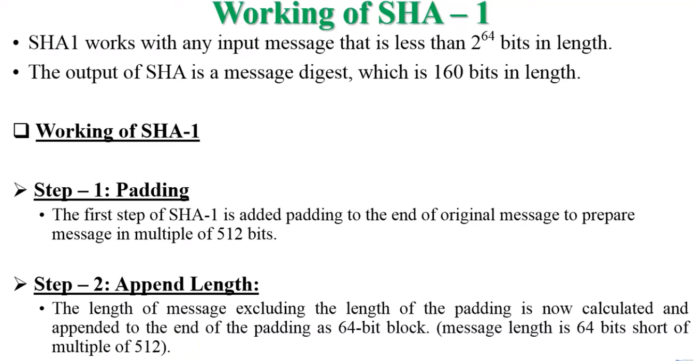

Slide 21
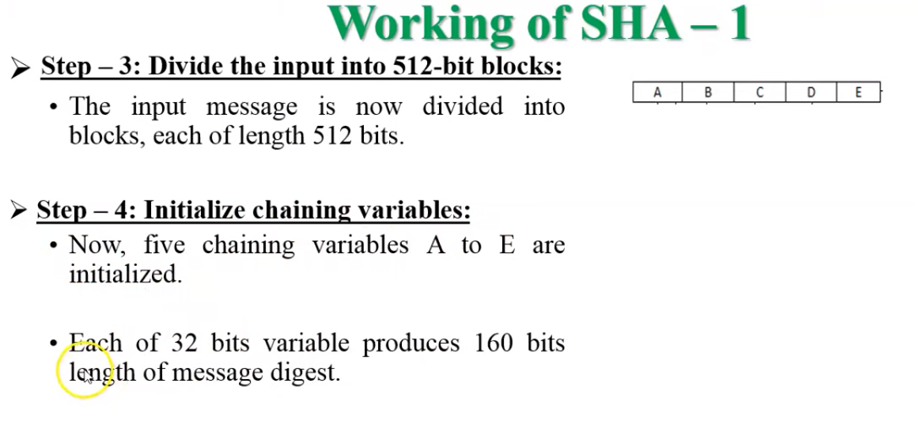

Slide 22
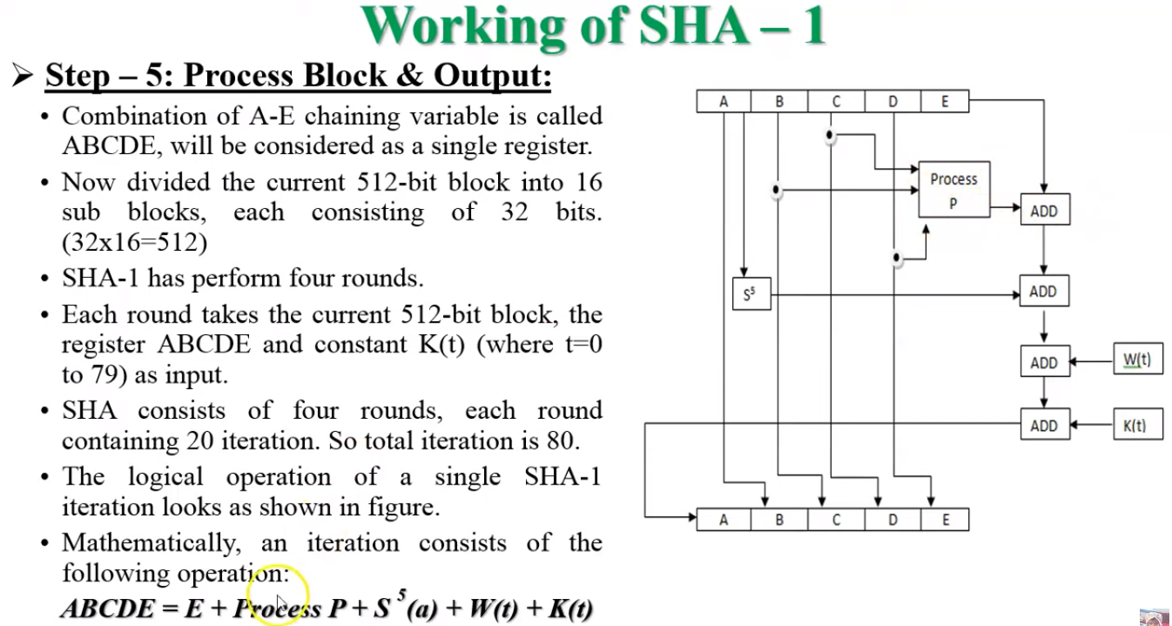

Slide 23
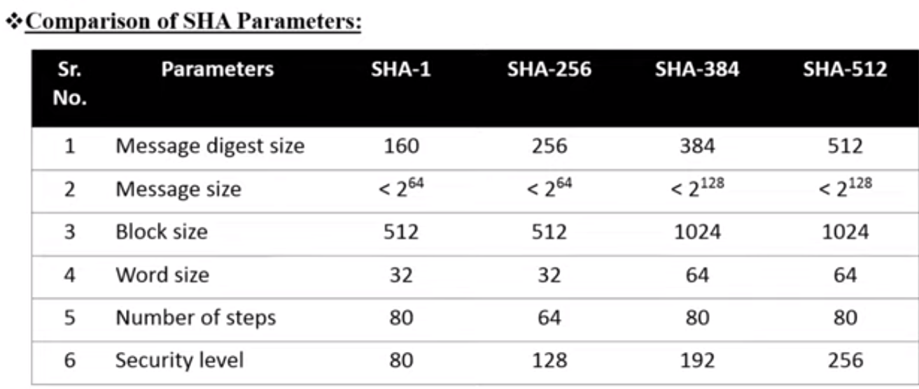

Slide 24
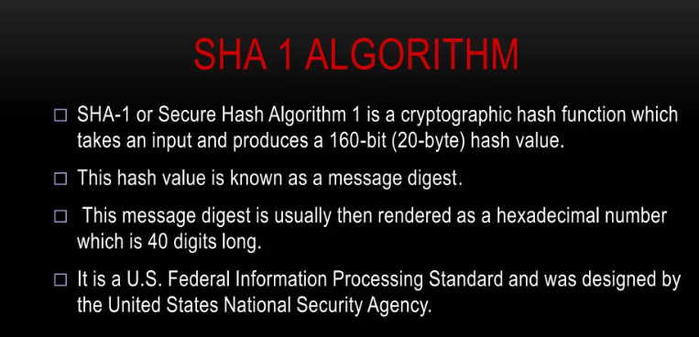

Slide 25
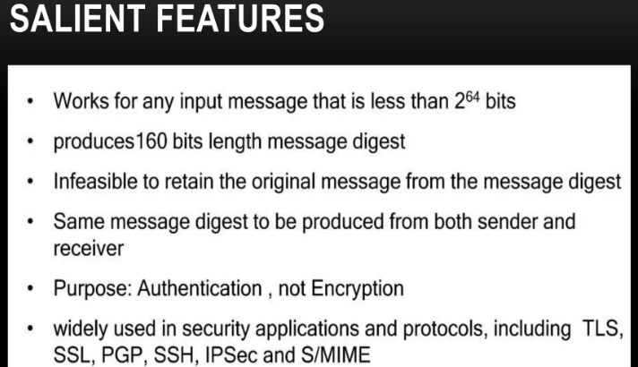

Slide 26
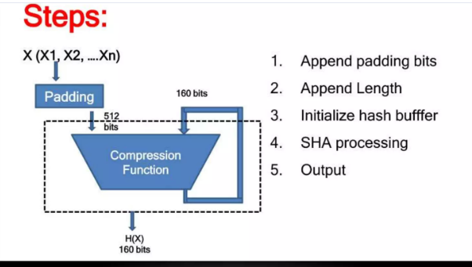
Steps involved in Hash function

Slide 27
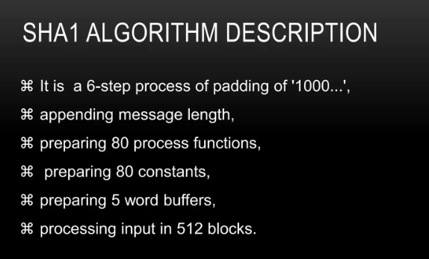

Slide 28
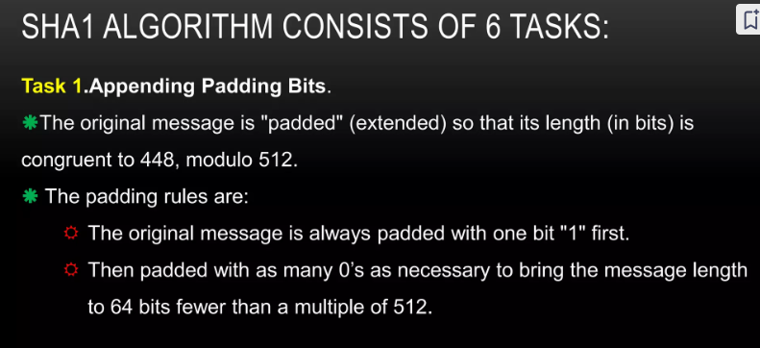

Slide 29
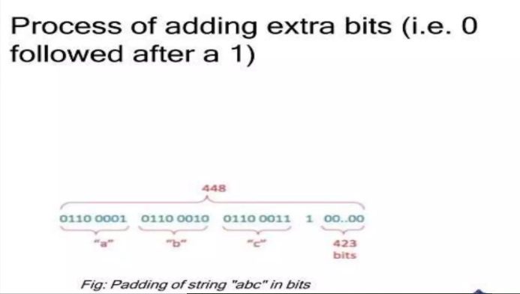

Slide 30
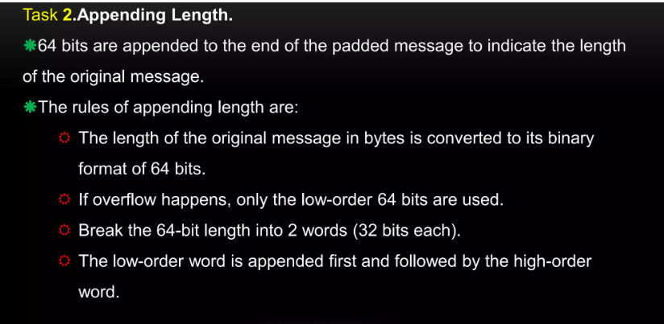

Slide 31
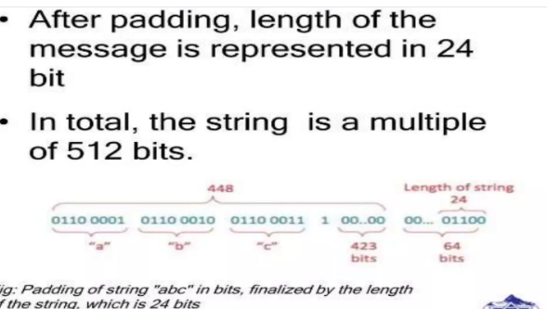

Slide 32
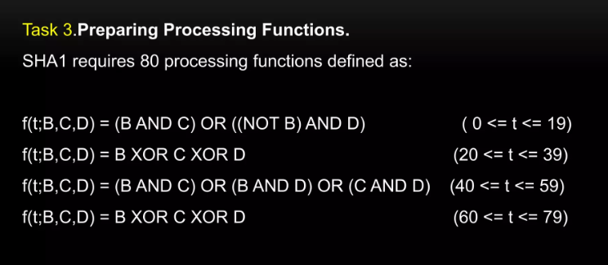

Slide 33
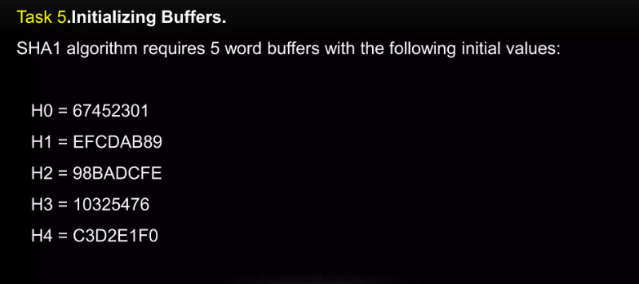

Slide 34
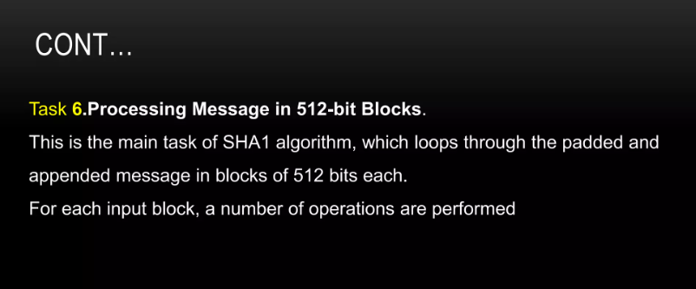

Slide 35
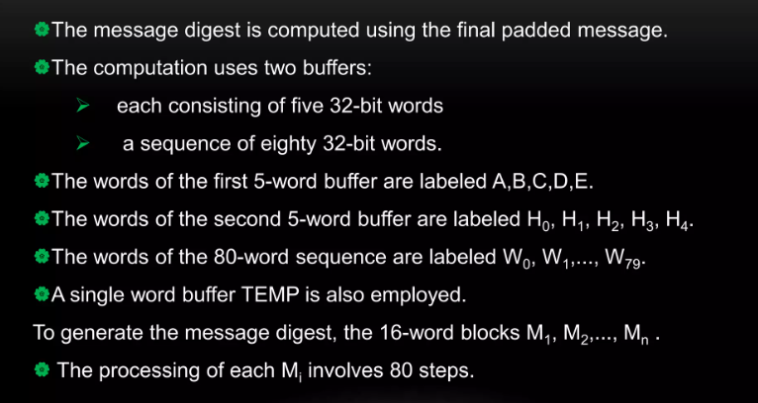
Compute the message Digest

Slide 36
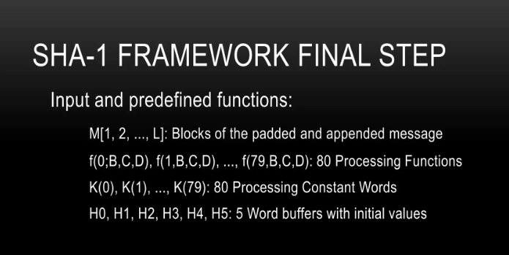

Slide 37
